Slide 1

OpenAI API
Chat
Settings

Slide 2
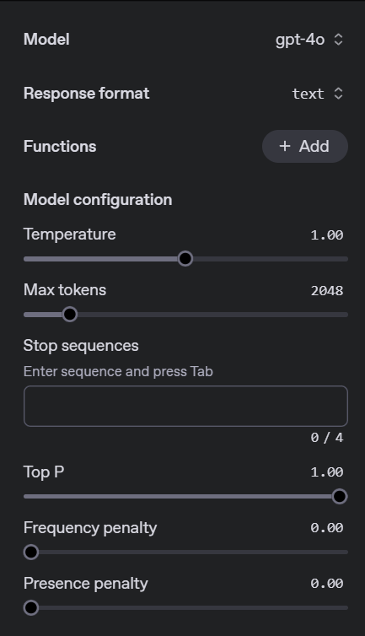
Notes:
https://platform.openai.com/playground/chat?models=gpt-4o

Slide 3
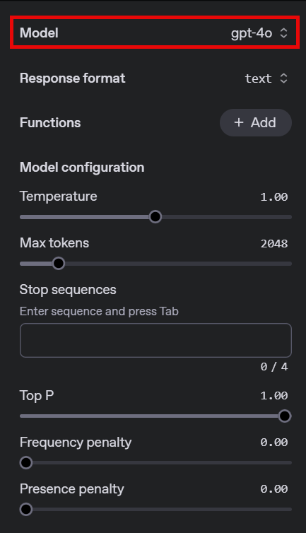
Model Choice

Slide 4
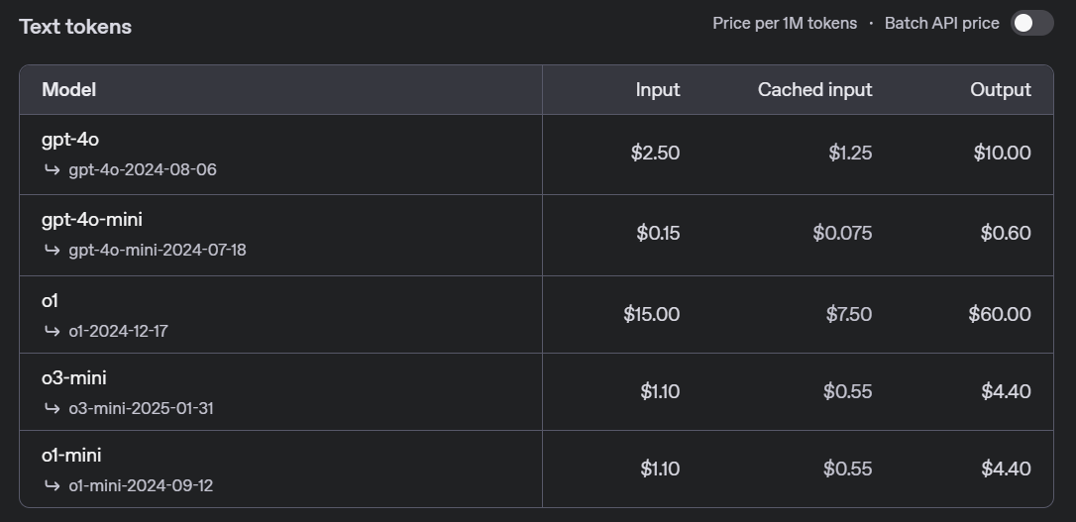
Model Choice = Money Choice
Notes:
https://platform.openai.com/docs/pricing

Slide 5
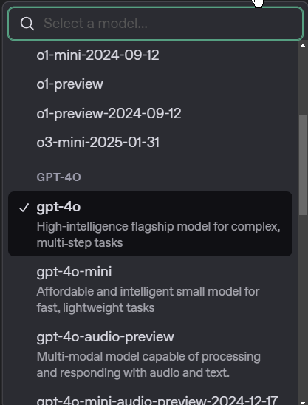
“Do I Need the BEST Model?”
$2.50
$0.15

Slide 6
DEMO: Model Output Comparison (4o vs 4o-mini)
Notes:
Show that, for general information, 4o-mini is just as good or better than 4o
Prompt: “What is a penguin?”

Slide 7
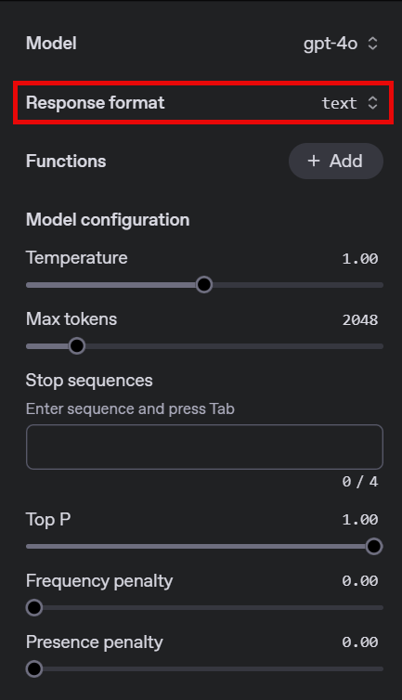
Response Format

Slide 8
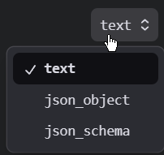
Response Format Options

Slide 9
DEMO: Response Format
Notes:
Text: What is an emperor penguin?
Json_object: What is an emperor penguin? Give me the answer in JSON format.
Json_schema: What is an emperor penguin? (use schema file included with the materials)

Slide 10
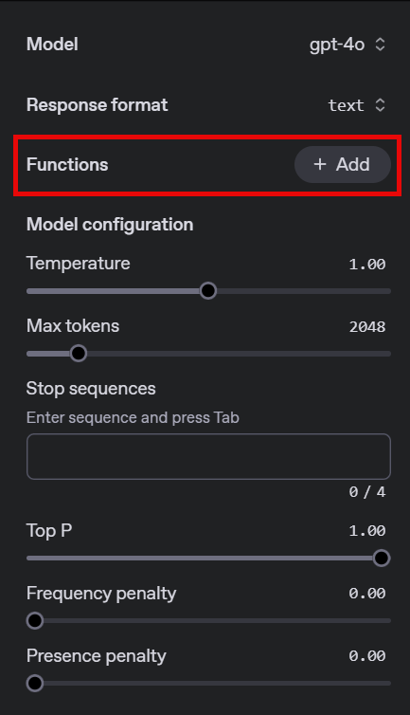
Functions

Slide 11
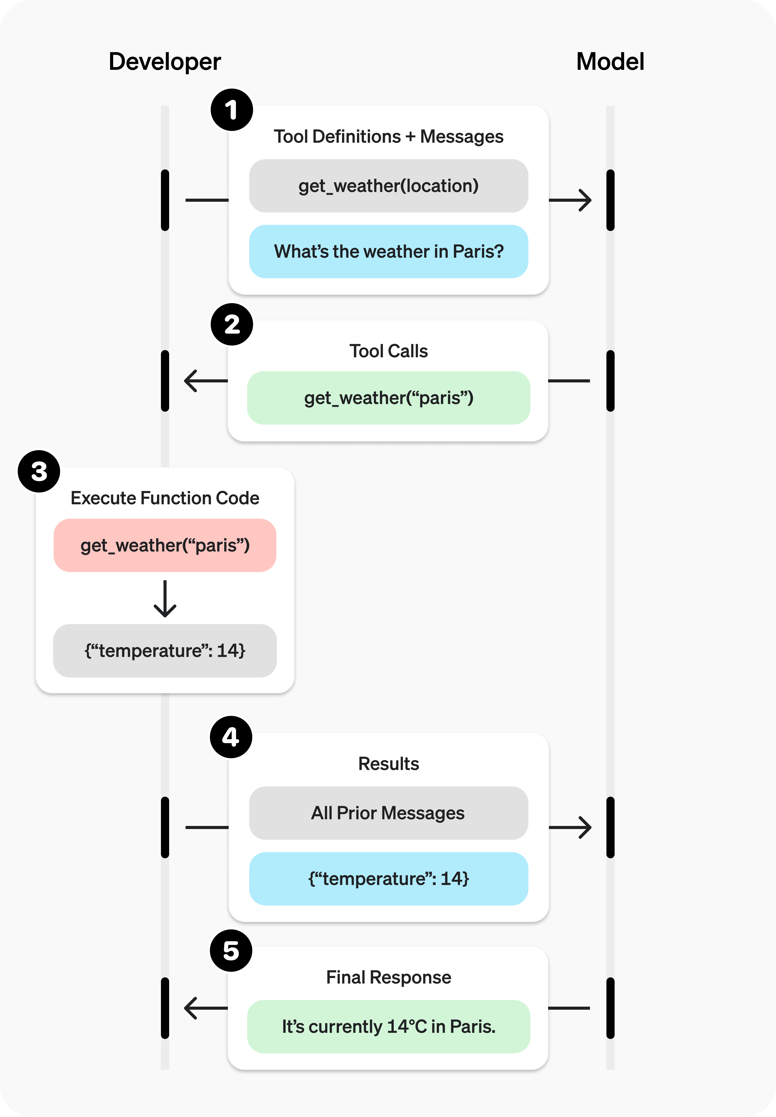
Functions
Notes:
https://platform.openai.com/docs/guides/function-calling#overview
Explain functions at a high level but don’t get to deep. We will go very deep into functions in a later session. For now, just give them the concept.

Slide 12
DEMO: Functions
Notes:
Use the weather example in functions and show how “normal” activity doesn’t trigger the function but when you ask for the weather the function gets triggered.

Slide 13




Notes:
https://www.youtube.com/channel/UC35ZpwldGw7ZJ5R-2sLijzw

Slide 14
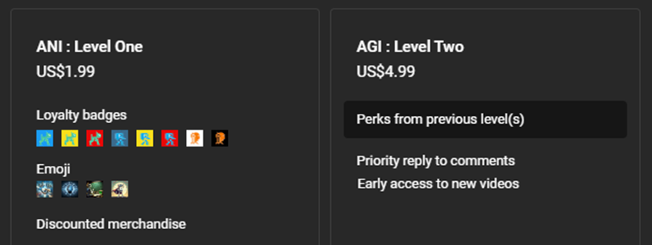
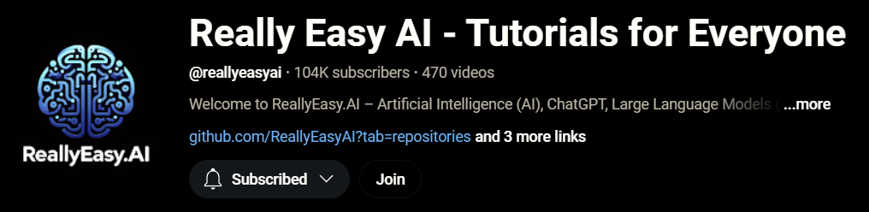
Notes:
https://www.youtube.com/@reallyeasyai/join

Slide 15
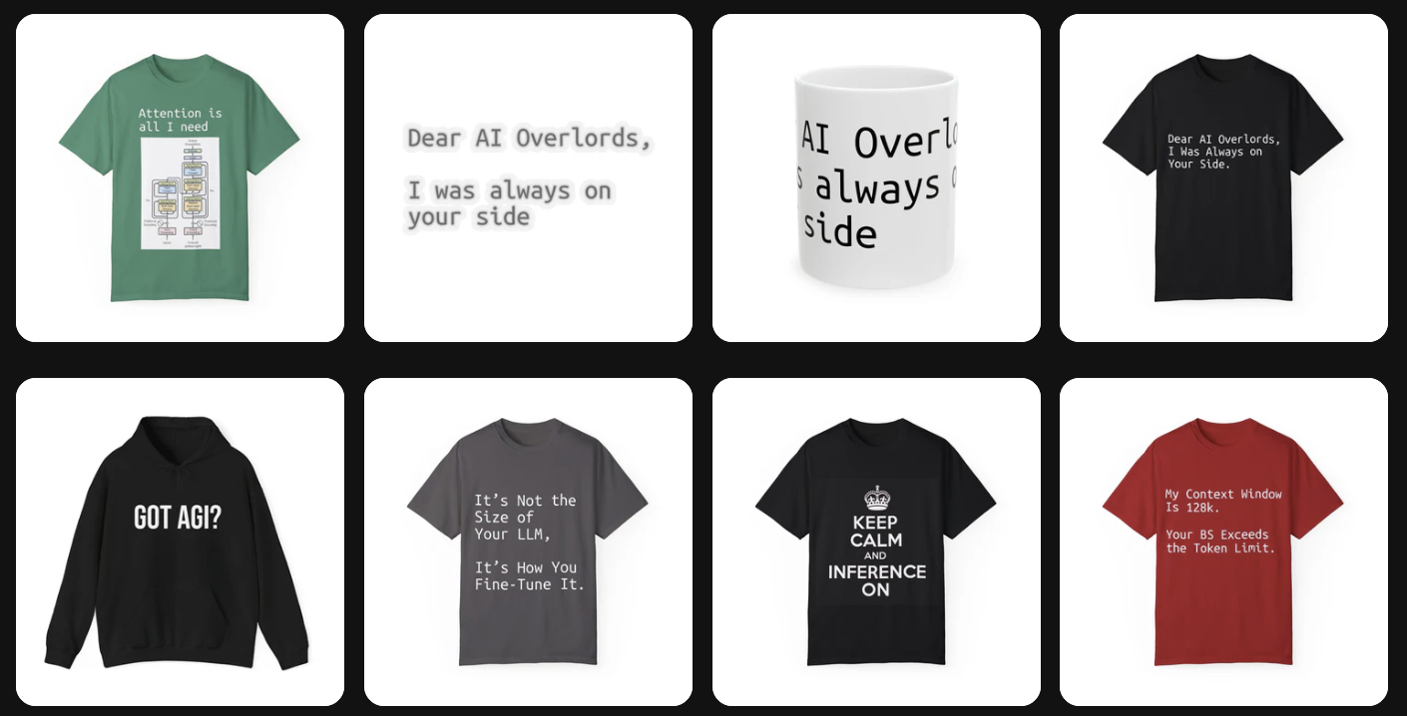
https://shop.reallyeasy.ai
Notes:
https://shop.reallyeasy.ai

Slide 16

https://www.youtube.com/@ainewsfresh
Notes:
https://www.youtube.com/@ainewsfresh

Slide 17

https://www.youtube.com/@aipaperspodcastdaily
Notes:
https://www.youtube.com/@aipaperspodcastdaily

Slide 18
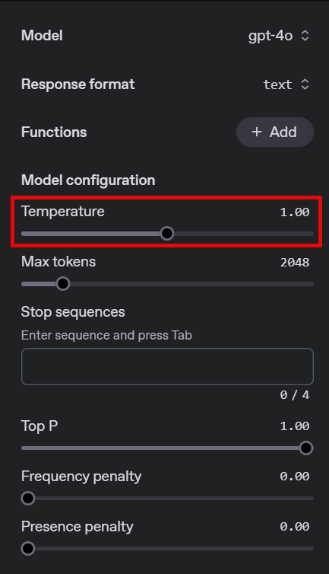
Temperature

Slide 19
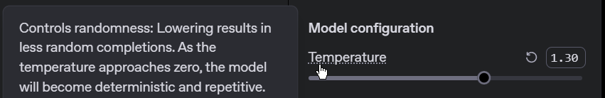
Temperature = “random creativity”

Slide 20
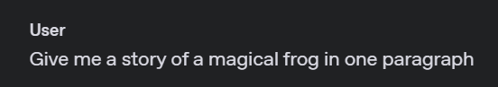
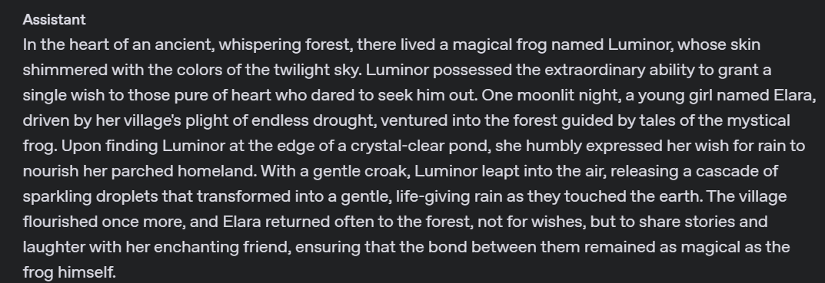
Temperature Setting 0

Slide 21
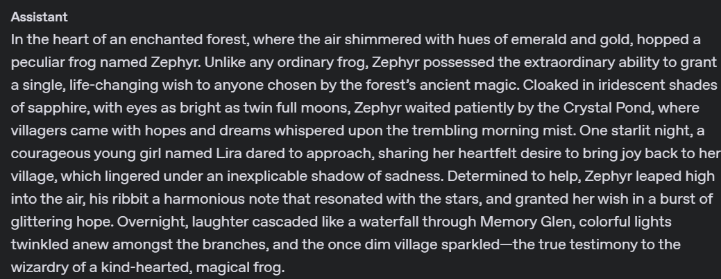
Temperature Setting 1.30

Slide 22
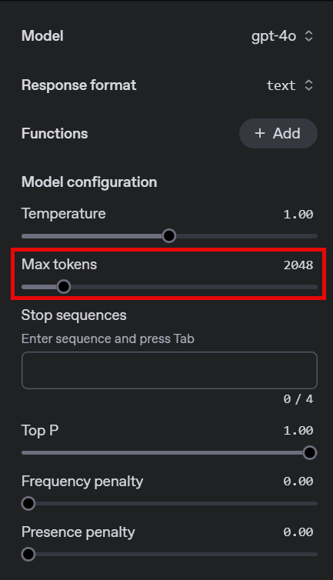
Max Tokens

Slide 23
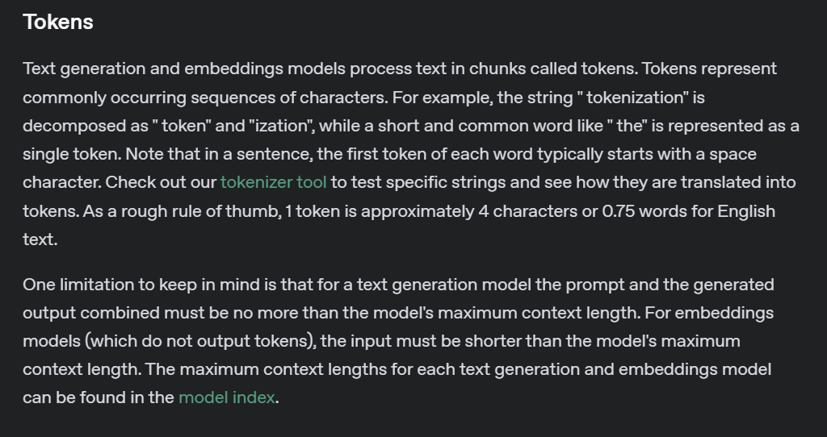
What Are Tokens?
Notes:
https://platform.openai.com/docs/concepts#tokens

Slide 24
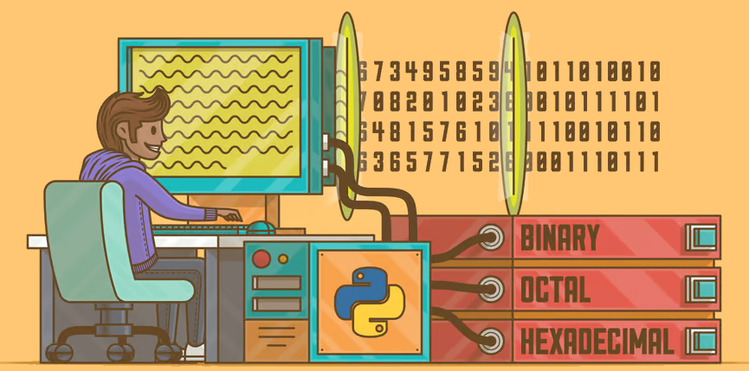
Characters | C | h | a | t | G | P | T
ASCII Values | 67 | 104 | 97 | 116 | 71 | 80 | 84
Binary Values | 01000011 | 01101000 | 01100001 | 01110100 | 01000111 | 01010000 | 01010100

Slide 25
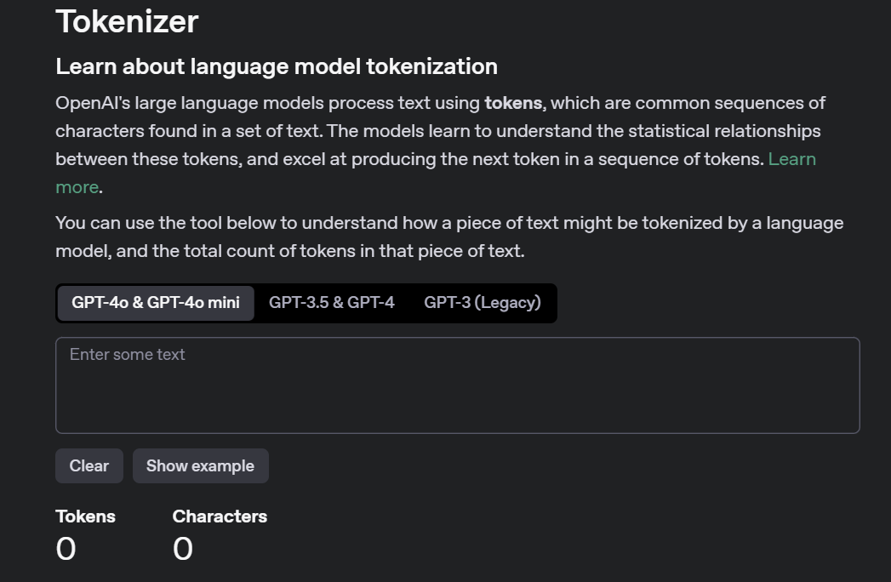
Notes:
https://platform.openai.com/tokenizer

Slide 26
DEMO: Using the Tokenizer
Notes:
Play around with different phrases and show how sometimes the token is a “word” and sometimes it isn’t. Make sure they understand the concept of a token.

Slide 27
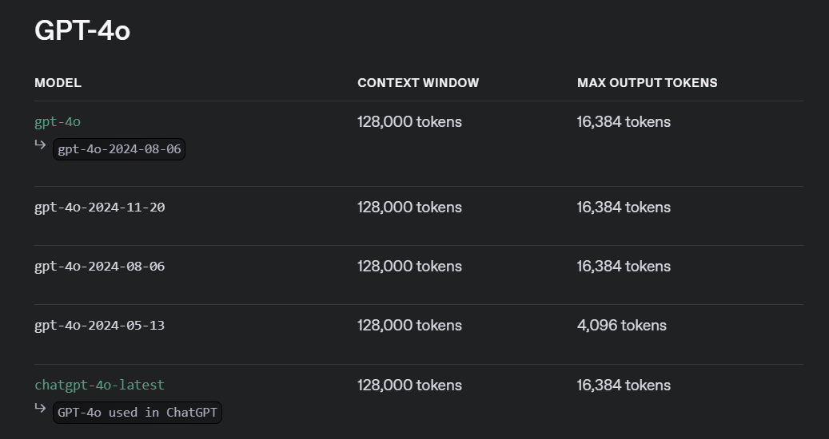
Input & Output Tokens: GPT 4o
Notes:
https://platform.openai.com/docs/models#gpt-4o

Slide 28
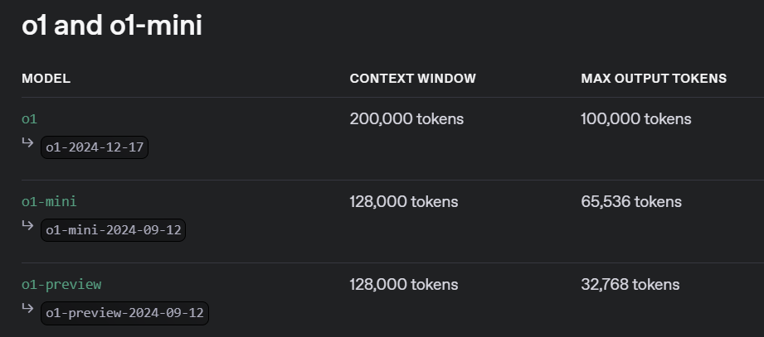
Input & Output Tokens: o1
Notes:
https://platform.openai.com/docs/models#o1

Slide 29

Context Window
System Instructions - They set the high-level behavior and rules for the model.
User Prompts - They are the inputs you provide to start or continue the conversation.
Model Responses - They are the outputs generated by the model based on the given context.
Conversation History - They are the previous messages that maintain context and continuity in the dialogue.

Slide 30
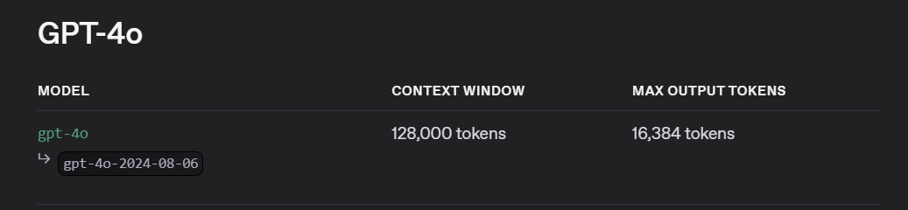
≈96,000 words
≈12,288 words

Slide 31
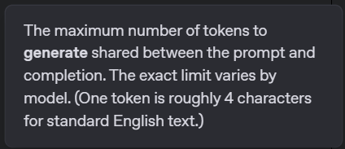
Max Tokens
Prompt Tokens
Completion (Output) Tokens

Slide 32
DEMO: Max Tokens
Notes:
Show generating any output with a very small max tokens setting and then with a bigger one.

Slide 33
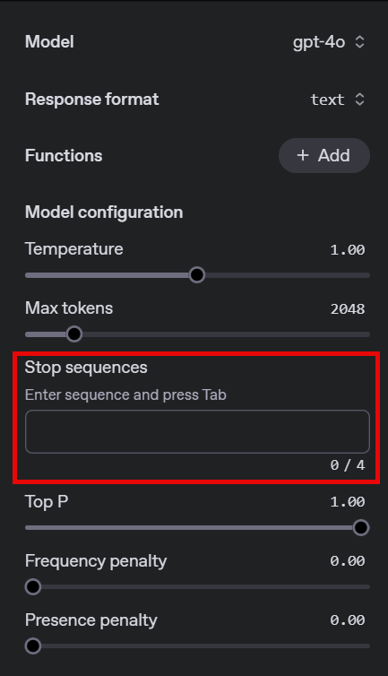
Stop Sequences

Slide 34
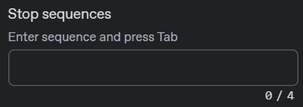
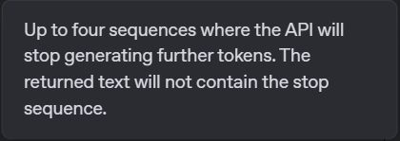

Slide 35
DEMO: Stop Sequences
Notes:
User: What is a penguin?
Run without any stop words then run with a stop word of “they” to show how these work. Have fun with it! ☺

Slide 36
OpenAI API
Chat
Settings

